Slide 1
Atmospheric Composition Applications of ACX using TEMPO as a Proxy
Gregory Frost¹, Shobha Kondragunta², Monika Kopacz¹, Victoria Breeze¹, Kathryn Mozer¹, Shiv Das¹
¹NOAA Office of Oceanic and Atmospheric Research
²NOAA National Environmental Satellite, Data, and Information Service

Slide 2
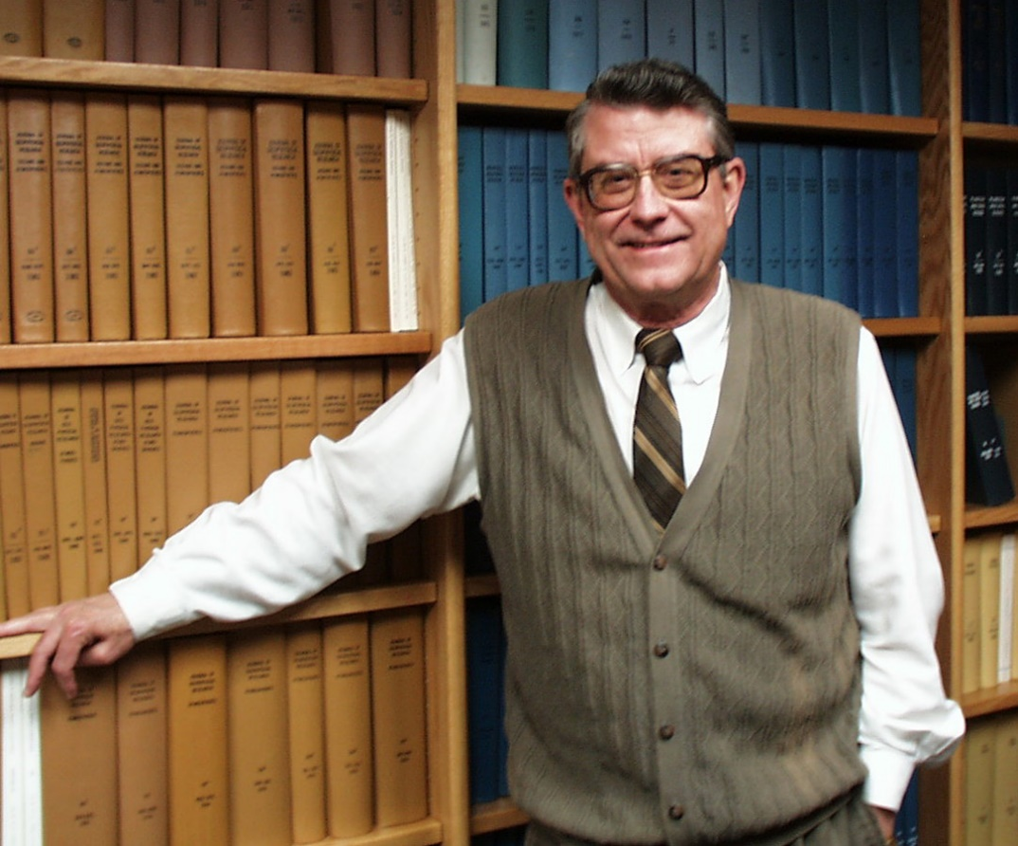
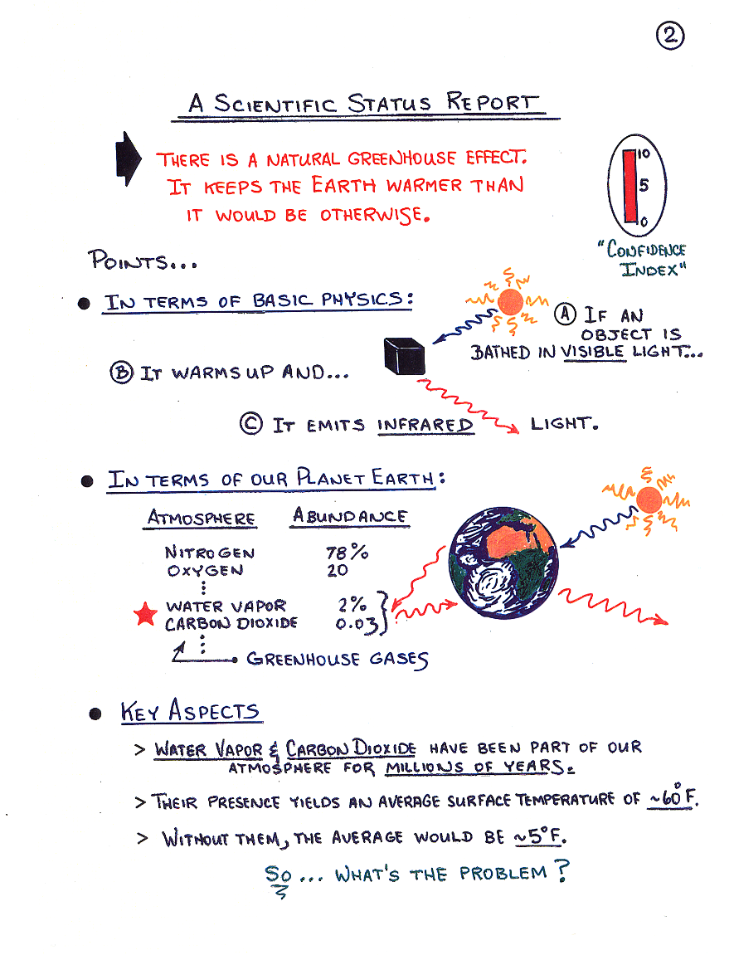
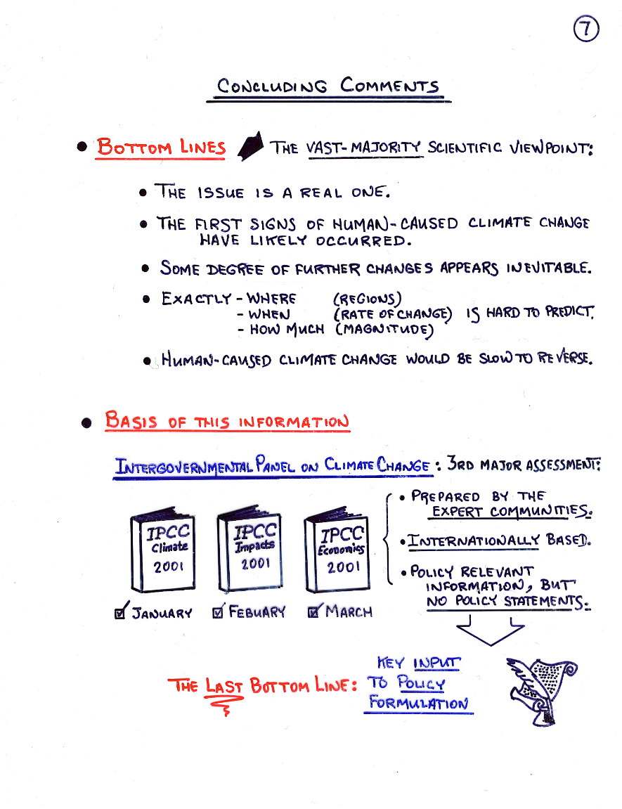
Remembering Dan Albritton
8 June 1936 – 1 April 2023
https://csl.noaa.gov/news/2023/374_0410.html
2 of Dan’s hand-written transparencies from his “Climate 101” briefing to Vice President Dick Cheney and members of President G.W. Bush’s Cabinet in early June 2001

Slide 3
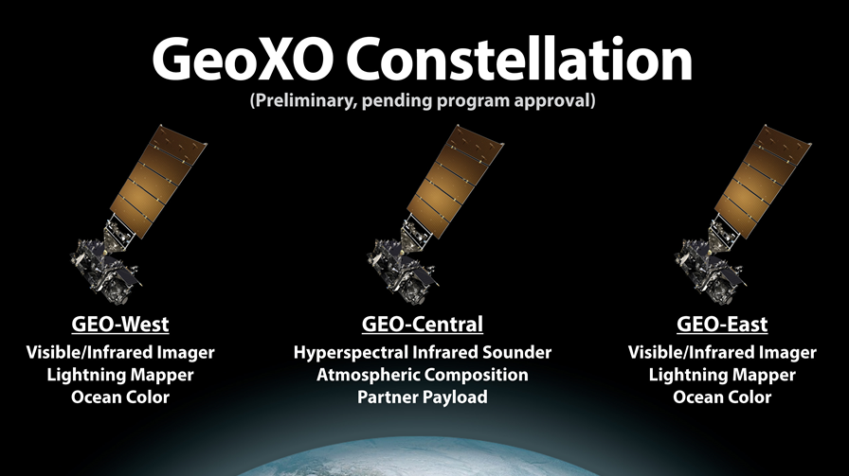
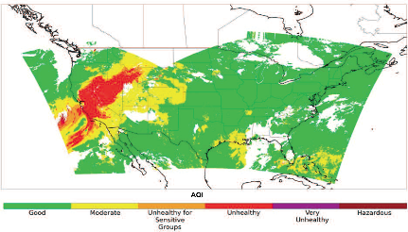

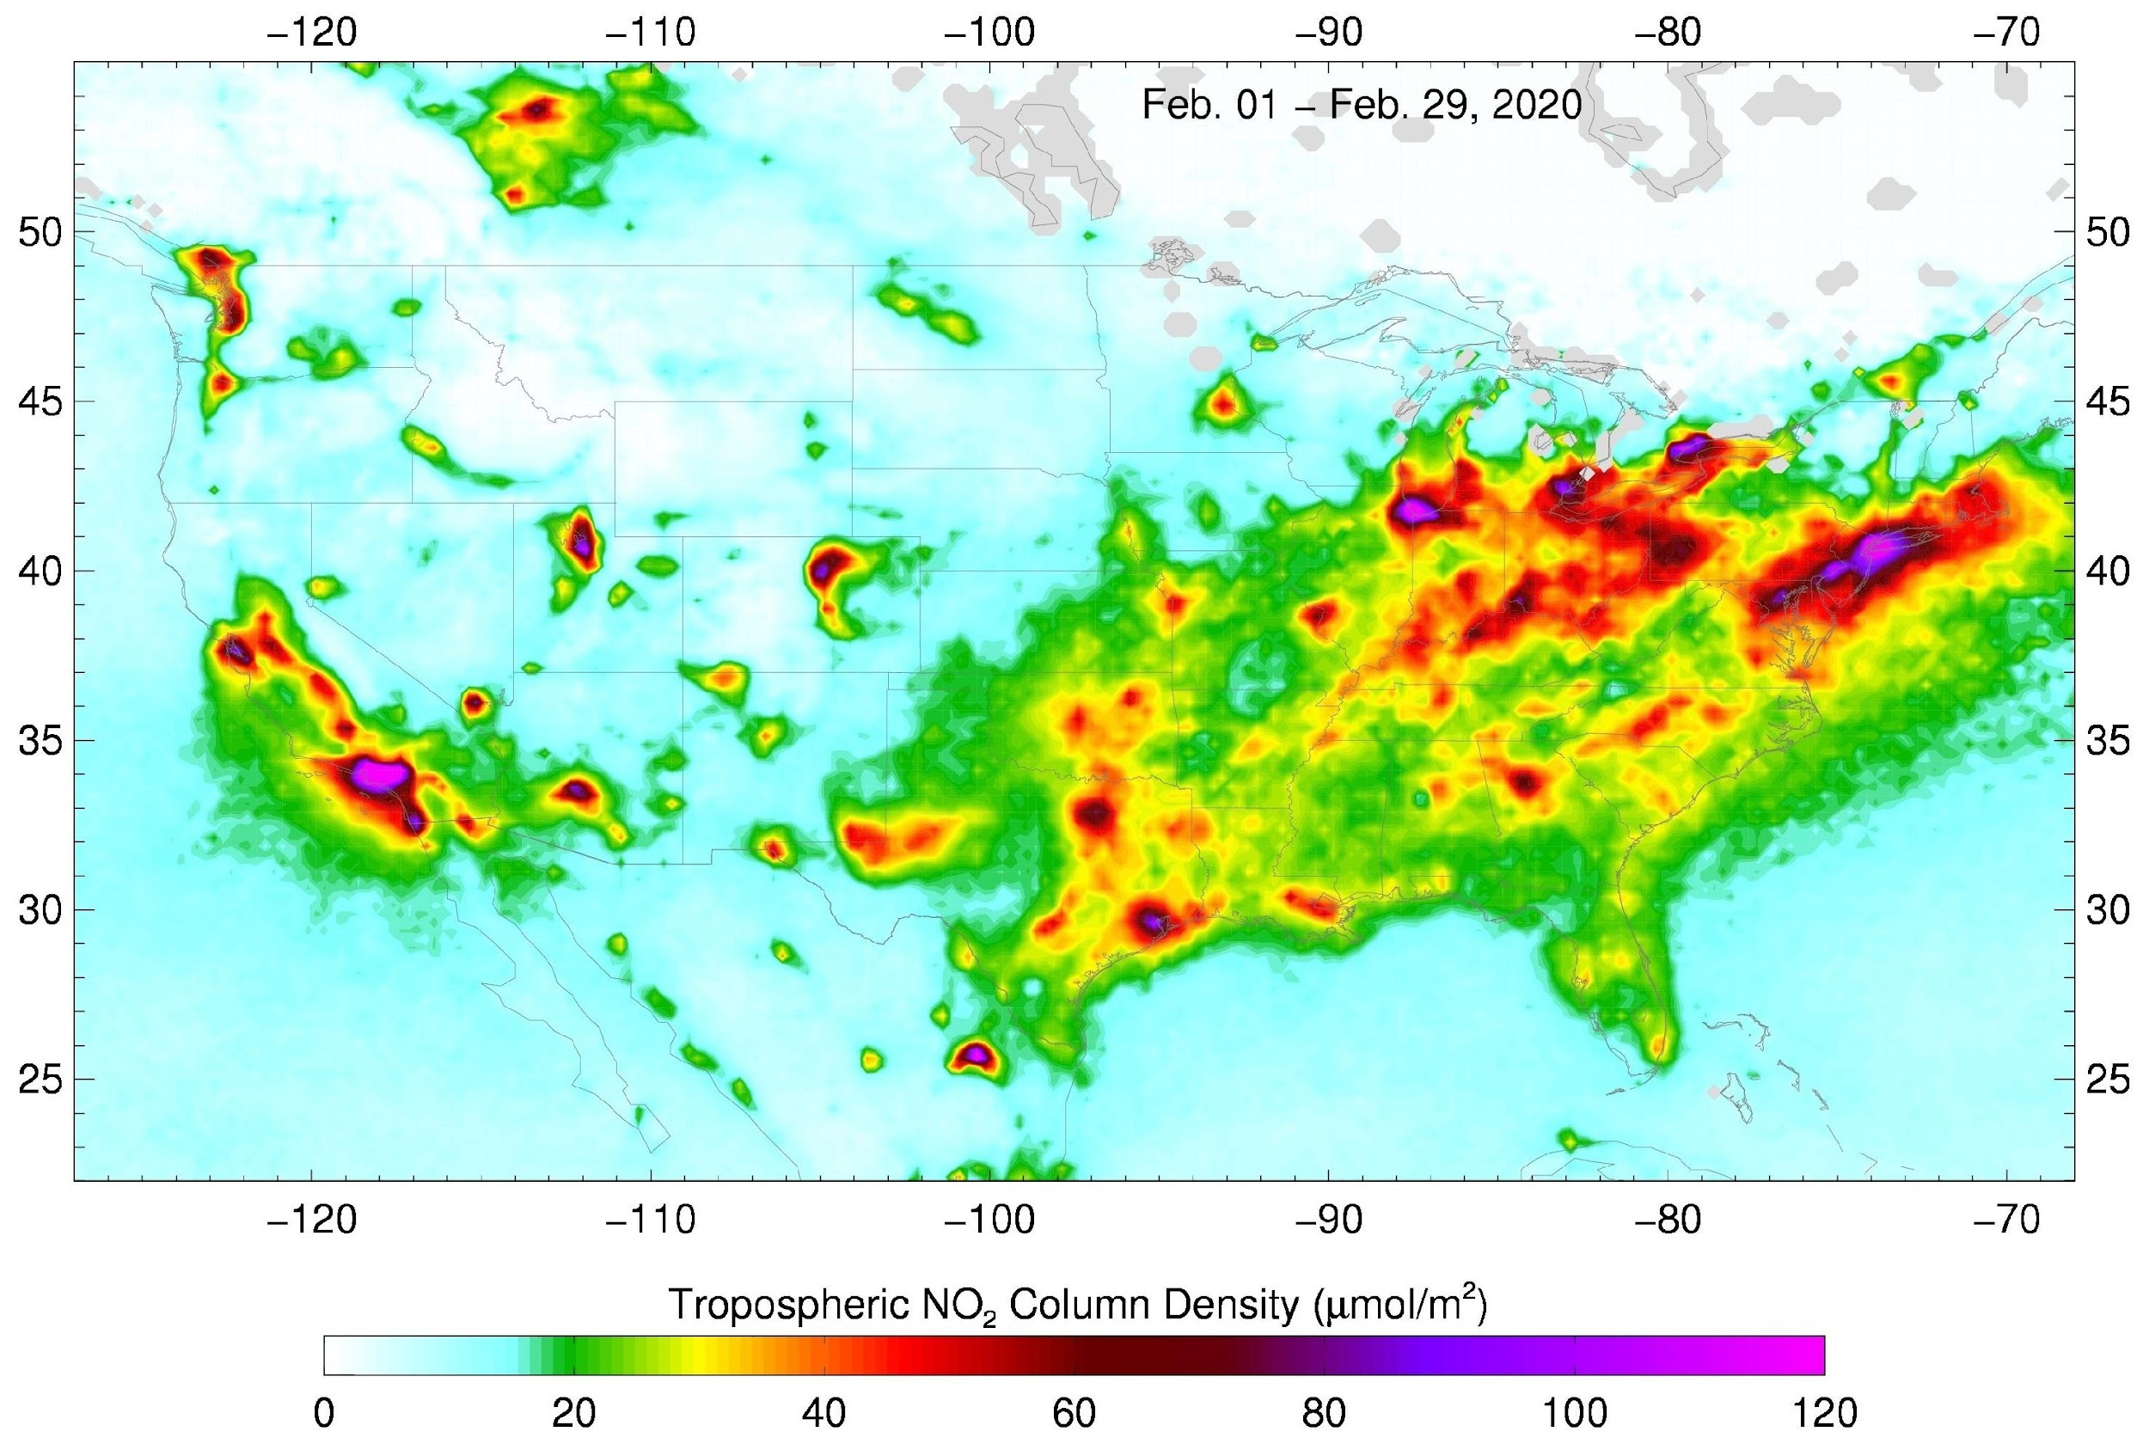
GeoXO atmospheric composition will be a multi-instrument strategy for various NOAA applications
Applications
Near real time emissions | Air quality forecasting
Air quality monitoring | Fire weather forecasting
Fire emissions monitoring | Ozone monitoring
Hazards forecasting | Greenhouse gas monitoring
Climate modeling and Earth system science research
Fire detection
Fire radiative power
Aerosol type
Aerosol optical depth
Aerosol concentration
Ozone
Carbon monoxide
Carbon dioxide
Ammonia
Isoprene
Ozone
Nitrogen dioxide
Sulfur dioxide
Formaldehyde
Aerosol layer height
UV aerosol index
UV aerosol optical depth
VIS-IR IMAGER
GXI
IR SOUNDER
GXS
UV-VIS SPECTROMETER ACX

Slide 4
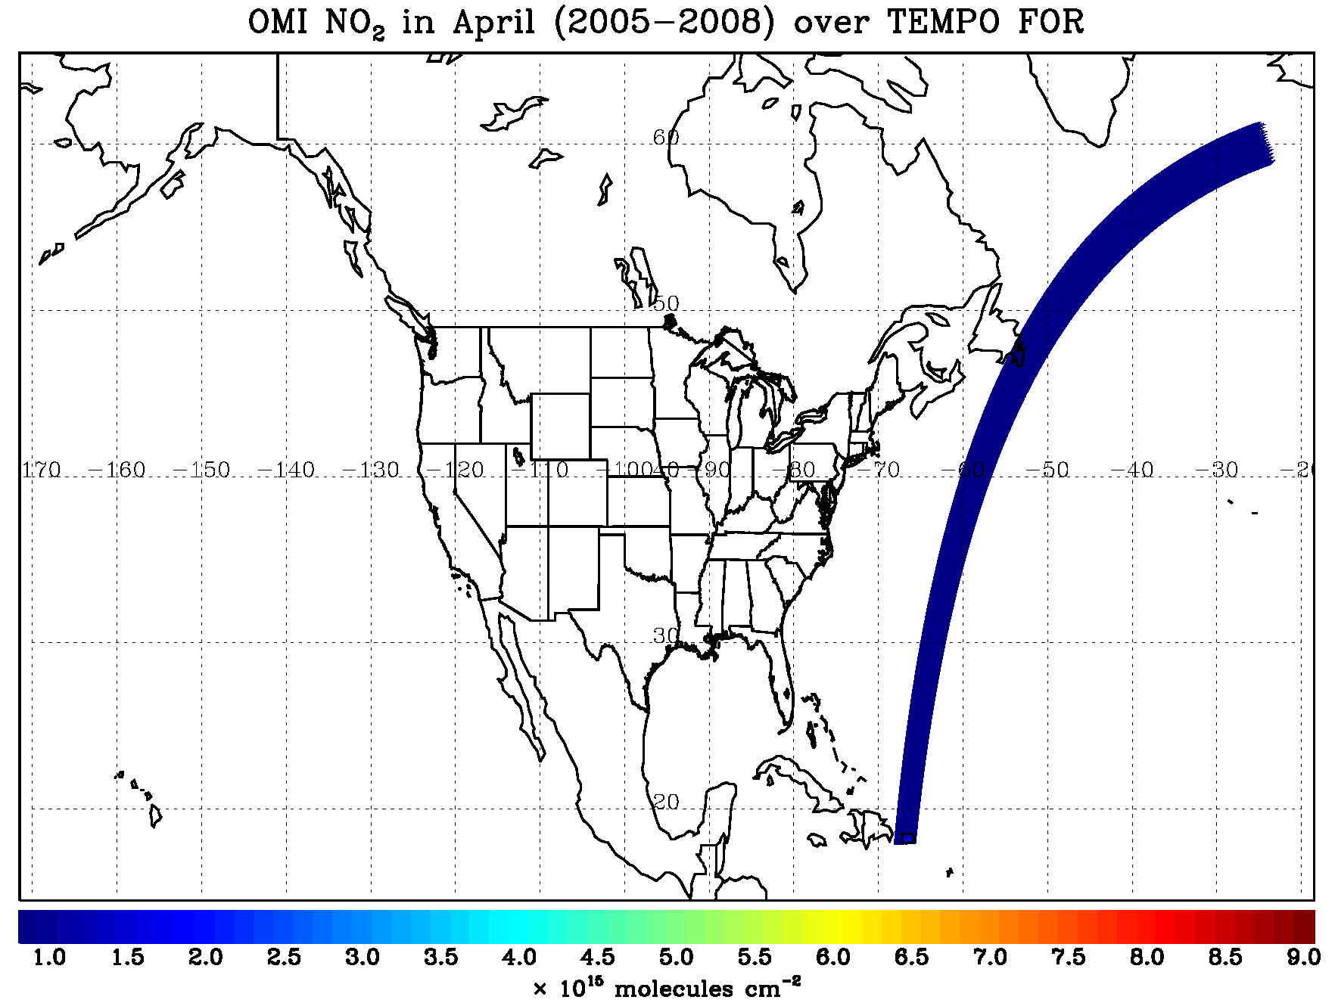
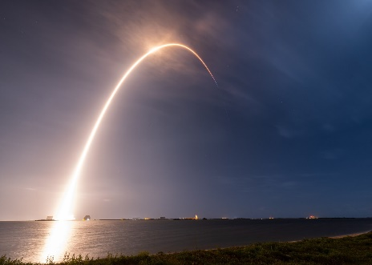
TEMPO = North American GEO AC Pathfinder
NASA’s TEMPO will provide GEO atmospheric composition observations over much of North America for research applications starting later this year
TEMPO is a pathfinder mission that offers a prototype with proving ground and risk reduction opportunities for ACX
ACX provides the research-to-operations transition of the GEO AC capabilities demonstrated by TEMPO
http://tempo.si.edu/index.html
4/7/23

Slide 5
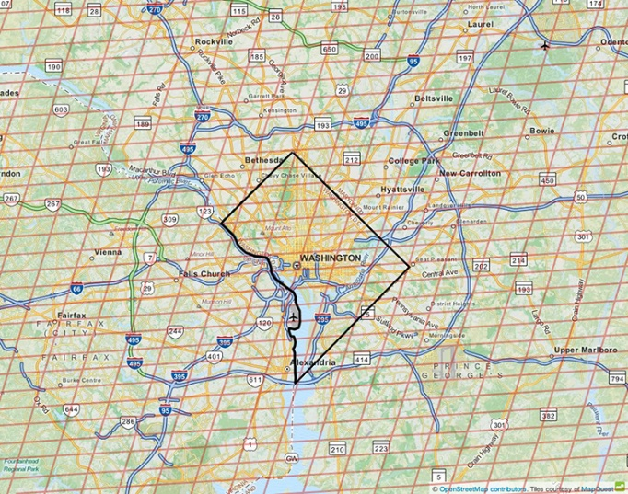
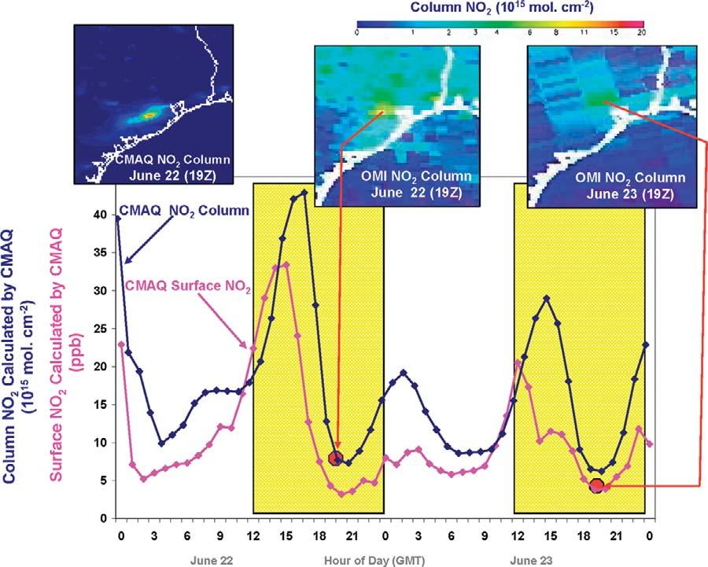
TEMPO provides guide for potential ACX attributes
TEMPO pixels over Washington DC region
Attribute | What | Why
Coverage | CONUS, southern Canada, northern Mexico, Caribbean | Hourly inputs to national air quality, hazard and fire forecasting capabilities and warnings.
Spatial Resolution | 8x3 km² @ nadir | Resolve sources, including cities, highway corridors, airports, oil/gas fields, large point sources like fires and power plants.
Temporal Resolution | 60 min | Capture diurnal variations in pollution emissions, photochemistry, and exposure. Detect episodic events like wildfires and volcanoes. Select for cloud-free conditions. Increase geographic coverage compared with LEO or surface observations.
Spectral Coverage / Resolution | UV: 300-500 nm Vis: 540-740 nm Both @ 0.6 nm | UV: ozone, nitrogen dioxide, formaldehyde, sulfur dioxide, absorption aerosol optical depth. Vis: cloud/aerosol layer height, PBL ozone, vegetation.
Fishman et al., BAMS, 2008

Slide 6
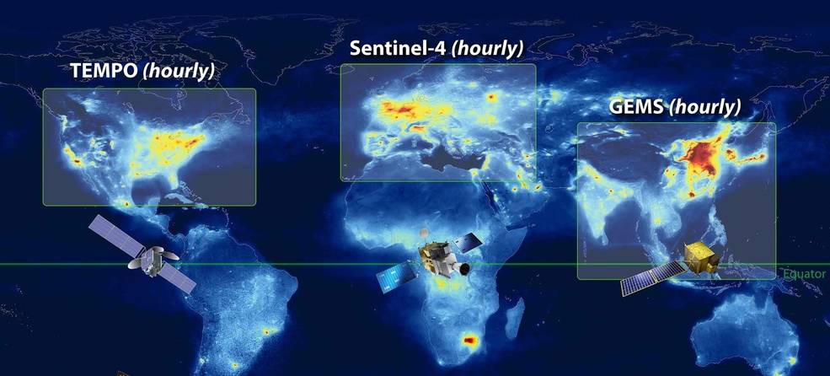
GeoXO ACX: NOAA’s Contribution to Geo-Ring
ACX will operationalize the North American GEO AC capability pioneered by TEMPO and will complement the operational Geo-Ring AC capabilities from Europe and South Korea

Slide 7
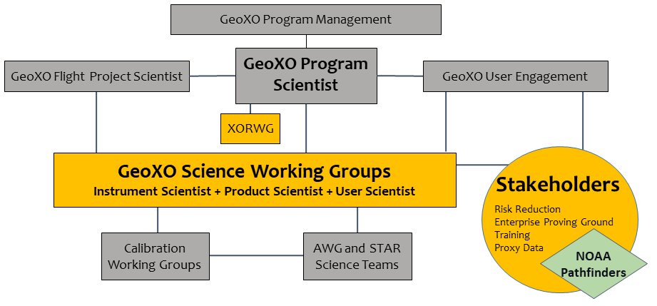
GeoXO Program provides support for activities to develop, evaluate, and demonstrate TEMPO products and their applications
ACX SWG
Instrument Scientist:
Joanna Joiner
Product Scientist:
Shobha Kondragunta
User Scientist:
Greg Frost

Slide 8
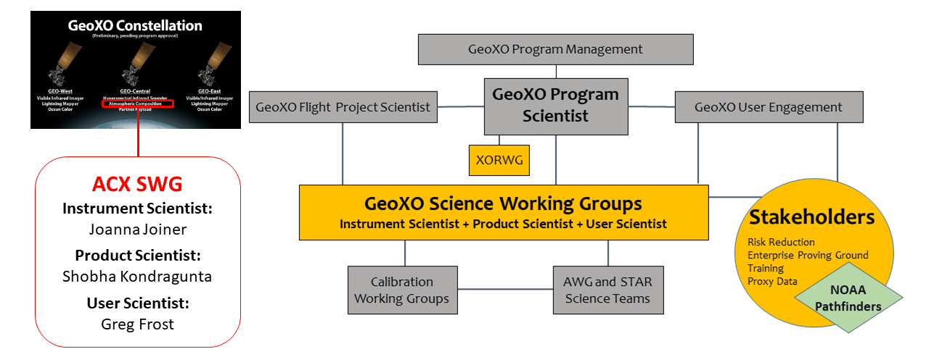
GeoXO Program provides support for activities to develop, evaluate, and demonstrate TEMPO products and their applications
Product development
Trace gases
Aerosols
Blended products
Evaluation proving grounds
Field campaigns
Long-term monitoring
Applications
Near-real-time emissions
Chemical data assimilation
Air quality forecasting
Pollution exposure studies
Environmental justice research
Partnerships
Existing stakeholders
ACX science team
Data exploration
User engagement
User readiness

Slide 9
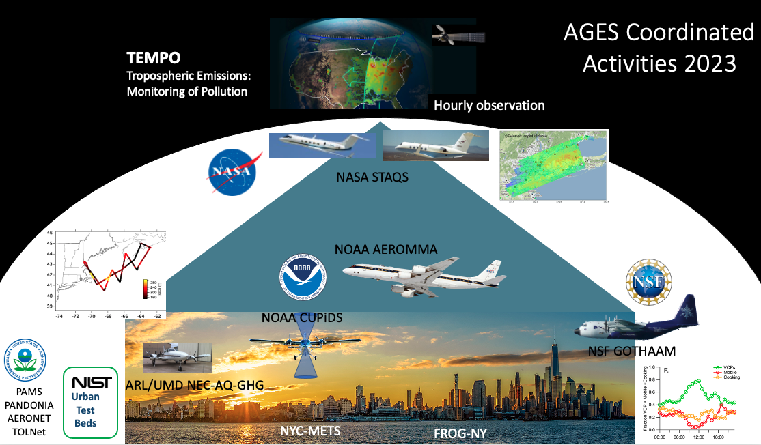
Summer 2023 field work will provide an unprecedented proving ground for evaluating observations from TEMPO and other satellite instruments
AGES+ Coordinated Activities 2023
https://csl.noaa.gov/projects/ages/
AGES+ =
AEROMMA+CUPiDS
GOTHAAM
EPCAPE
STAQS
+ …

Slide 10
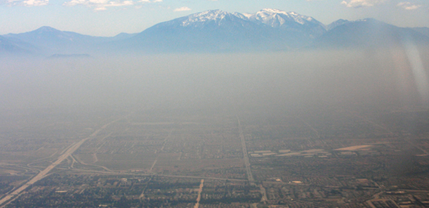
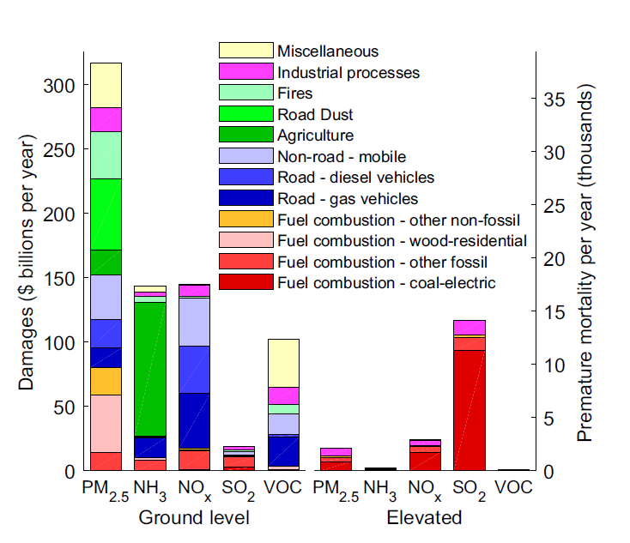
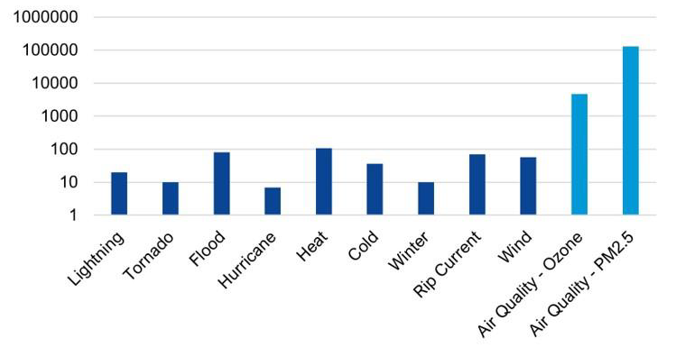
GEO capabilities for quantifying air pollution
Air pollution results in 100,000+ premature deaths and nearly $1T in damages in the U.S. annually, many times greater than damages from extreme weather events.
U.S. Damages from Air Pollutants by Source
Goodkind et al., Proc. Natl. Acad. Sci., 2019
Annual U.S. premature mortality
GOES ABI, TEMPO, and GeoXO’s ACX, GXI, and GXS will measure air pollutants that are harmful to human health, informing emissions estimates, air quality forecasts, and epidemiological studies.
ABI GXI
GXS
TEMPO ACX

Slide 11
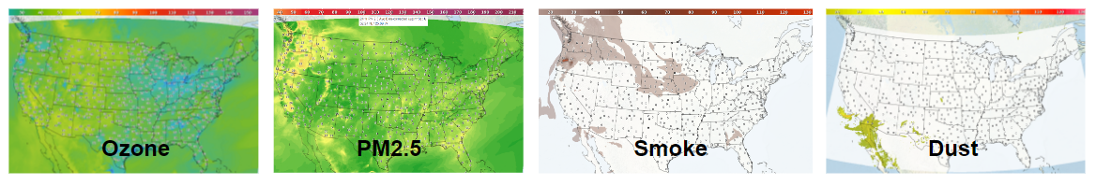
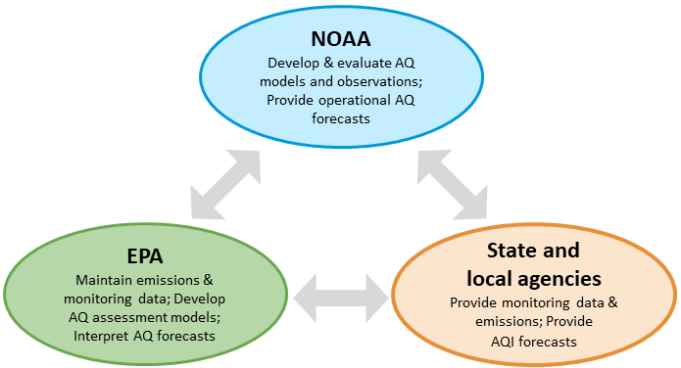
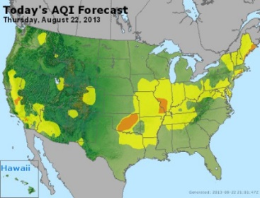
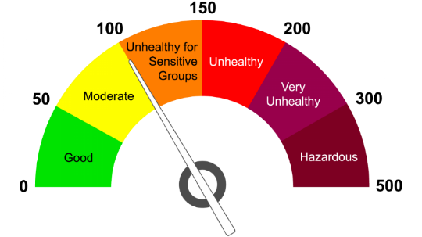
Potential for GEO observations to improve NOAA AQ forecasts
NOAA’s National Air Quality Forecasting Capability provides guidance to the US EPA and state/local agencies that monitor air pollutant levels and disseminate air pollution alerts, which lead to reduced exposure and lower health care costs.
Improvements in NOAA’s air quality forecasting capability from GOES, TEMPO and GeoXO AC observations could result in improved pollution alerts and better regulatory guidance, leading to billions of dollars saved, reduced health care costs, and lower premature mortality.

Slide 12
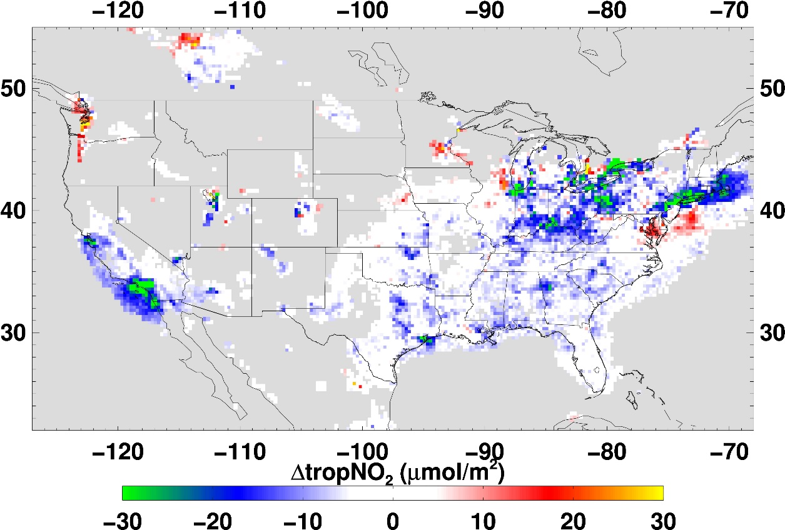
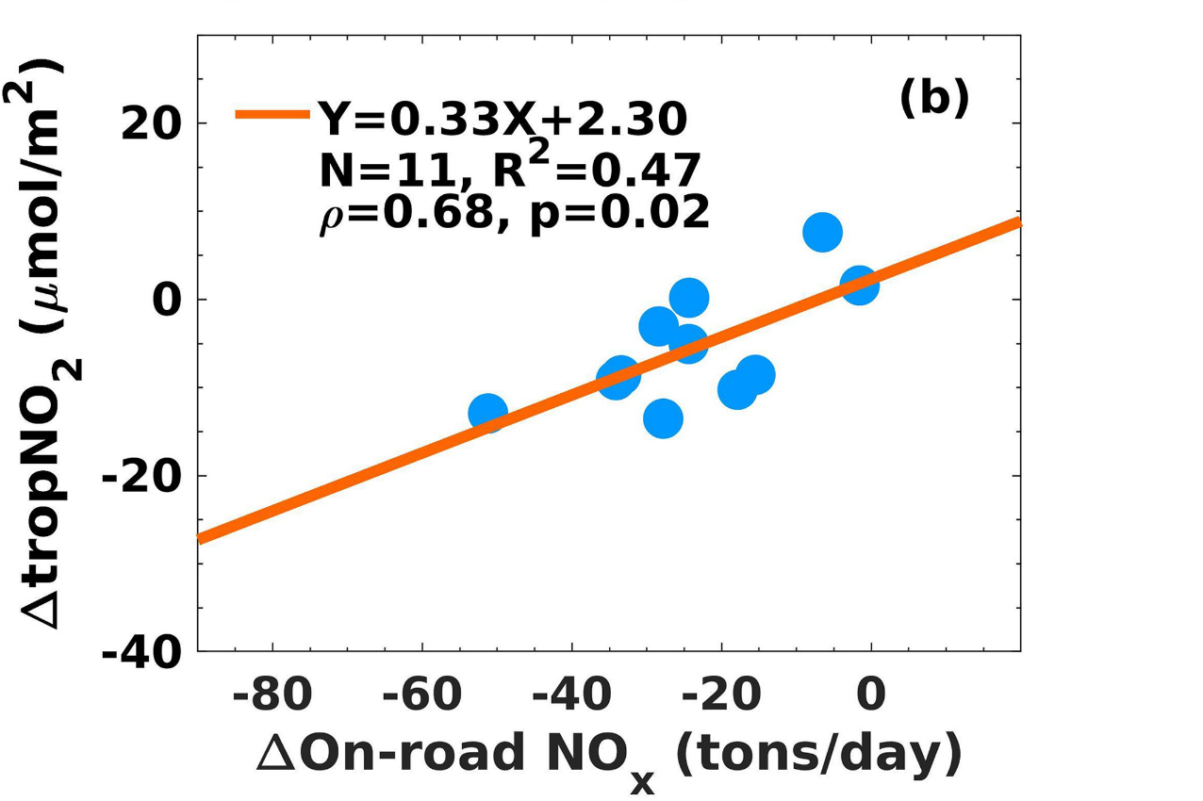
LEO AC data help to quantify rapid changes to emissions
Lower on-road NO_{x} emissions resulting from COVID-19 pandemic lockdowns correlated with changes in low-Earth-orbit satellite NO₂ data, providing opportunities to develop and optimize near-real-time emissions applications
S. Kondragunta, Z. Wei, B. McDonald, D. Goldberg, D. Tong, Fingerprints of a new normal urban air quality in the United States, JGR-Atmospheres, 2021

Slide 13
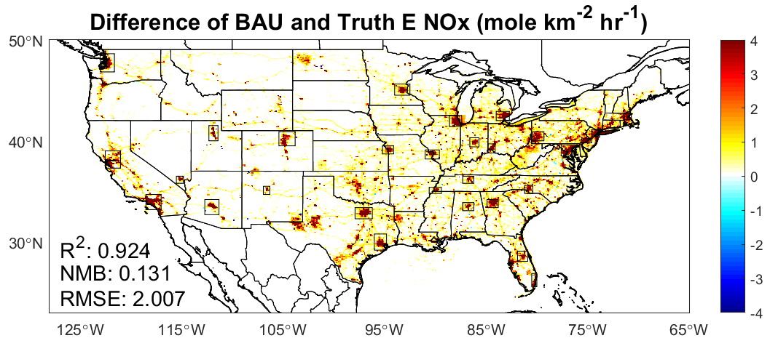
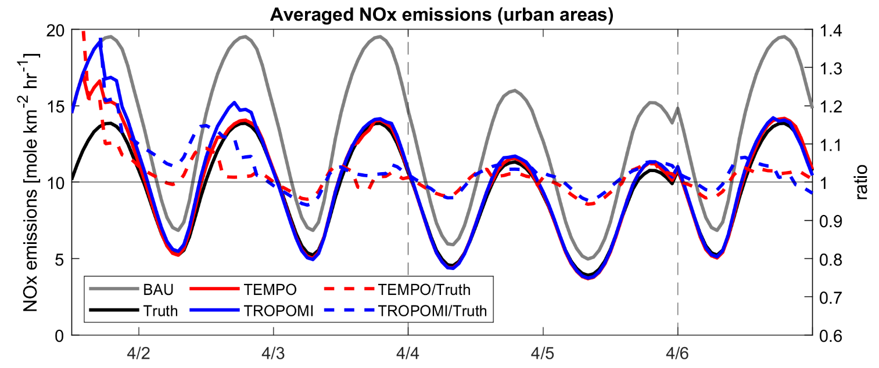
GEO AC data enable faster emissions updates than LEO
April 2020 NOx Emissions Differences
Business-as-usual (BAU) – COVID-19 period
TEMPO and ACX will allow more rapid generation of near-real-time emissions, faster assessment of unexpected emissions trends, and likely improve air quality forecasts compared with LEO AC datasets
E(NO_{x}), mole/km²/h
NOx Emissions in April 2020
True = COVID-19 period, BAU = Business-as-usual,
TEMPO = BAU adjusted using TEMPO proxy data
GeoXO Value Study: The Value of GeoXO Atmospheric Composition Observations for Emissions Updating and Air Quality Forecasting
PI: Brian McDonald, Co-Is: Chia-Hua Hsu, Arthur Mizzi, Daven Henze

Slide 14
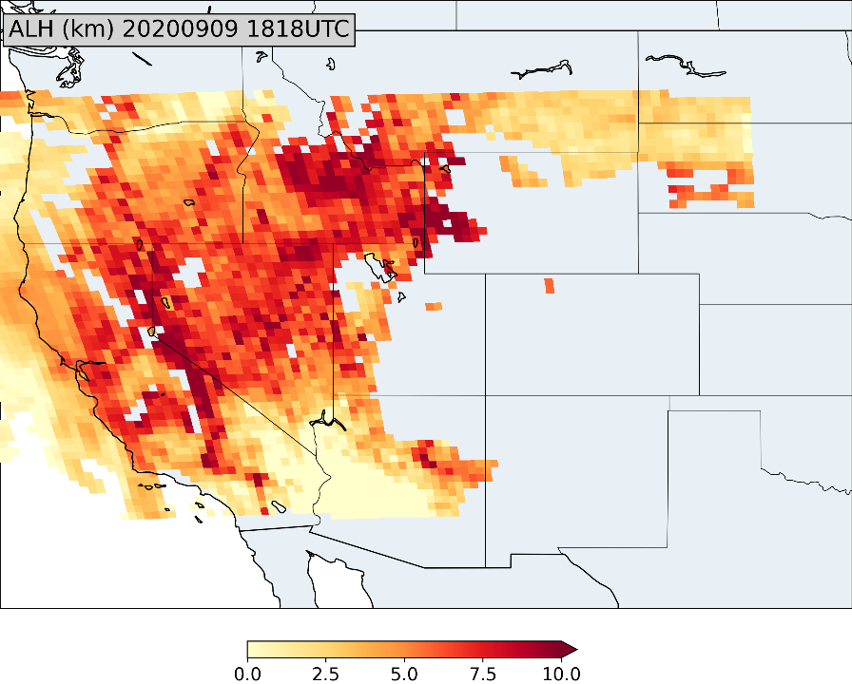
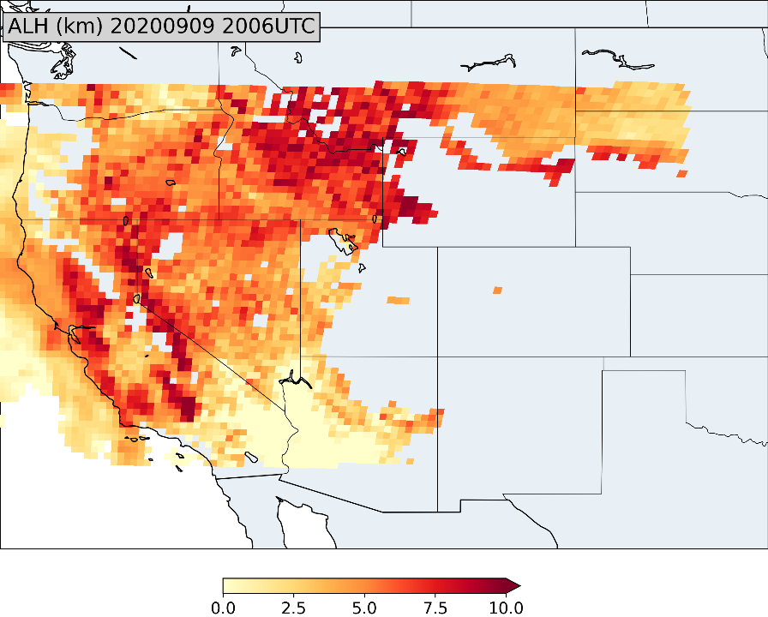
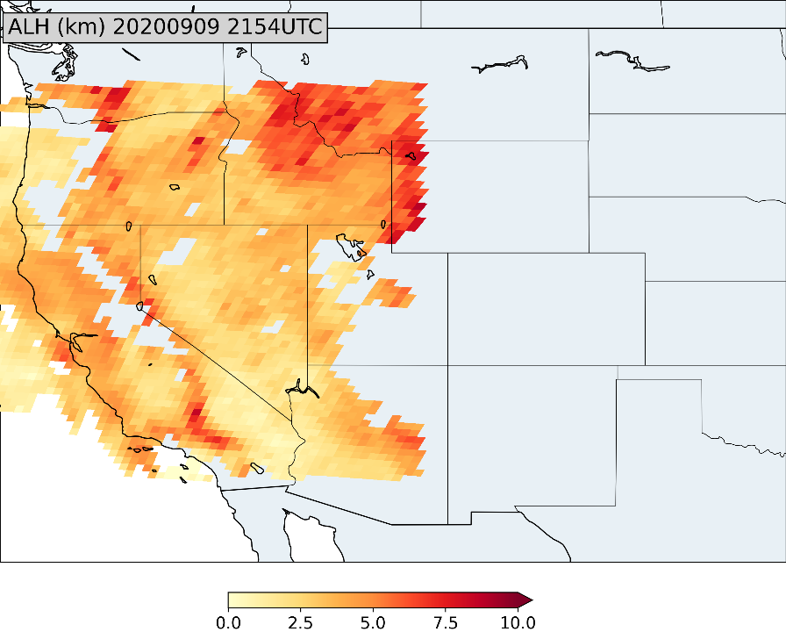
GEO data offer new insights on aerosols
TEMPO and ACX offer the opportunity to develop and apply new GEO aerosol products, like aerosol layer height derived from EPIC/DSCOVR observations, that will improve the understanding and prediction of aerosols as they evolve throughout the day at the surface and aloft.
1818 UTC
2006 UTC
2154 UTC
GeoXO Value Study: Advancing Aerosol Layer Height Retrieval for Surface PM2.5 Monitoring
PI: Jun Wang, Co-I: Shobha Kondragunta

Slide 15
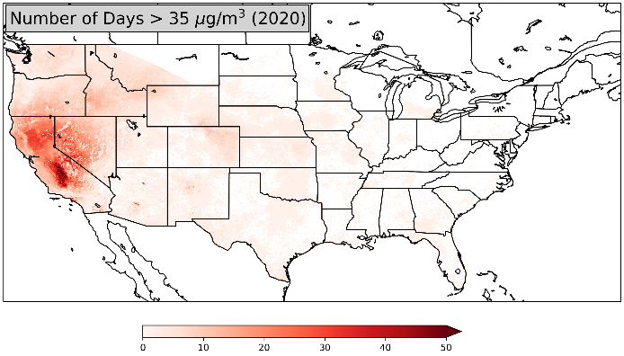
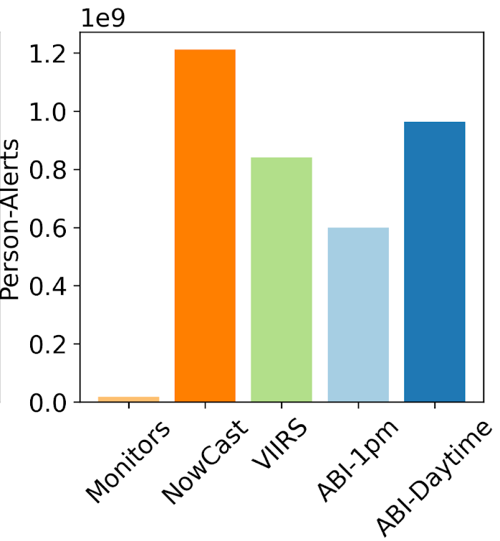
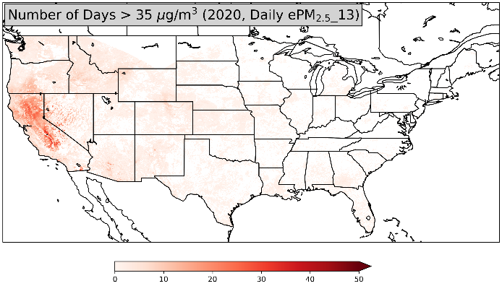
GEO AC data enhance pollution exposure studies
GOES, TEMPO and GeoXO observations provide enhanced estimates of exposure, more timely pollution alerts, and improved assessment of aerosol-attributable health impacts compared with LEO observations
Hai Zhang et al., Nowcasting applications of geostationary satellite hourly surface PM2.5 data, Weather and Forecasting, 2022
GEO
GEO sampled as LEO
GeoXO Value Study: Value of GeoXO Atmospheric Composition Data for Estimating Air Pollution-Related Health Impacts
PI: Susan Anenberg, Co-Is: Katelyn O’Dell, Gaige Kerr, Dan Goldberg
Number of Days

Slide 16






















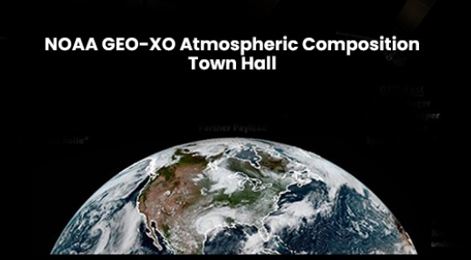
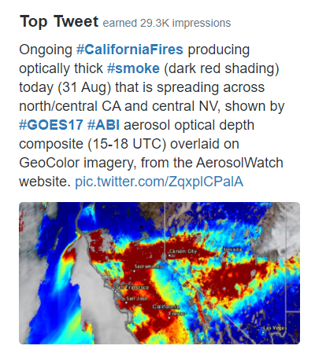


Stakeholders for NOAA’s atmospheric Composition Products
Who are our stakeholders?
Operational forecasters for air quality and weather
Federal, state, & local environmental regulators
Climate, stratospheric, & air quality monitoring teams
Environmental assessment bodies
Public health officials
Diplomats
Research community
Media
General public
How are we connecting with them?
Town halls
1-on-1 meetings
Website: in progress
GeoXO Pathfinder process
Social media: 2807 Twitter followers of @AerosolWatch
Trainings: https://www.star.nesdis.noaa.gov/atmospheric-composition-training/
29 April 2021

Slide 17
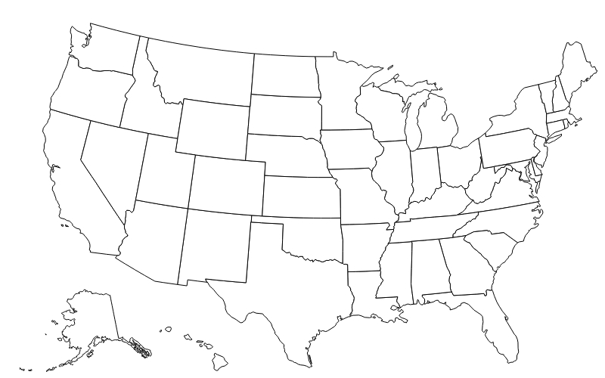



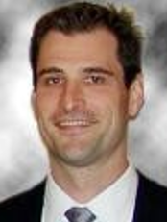


NOAA Pathfinders for Air Quality
Benefits for missions, products and services
NYC Air Quality
(Masha Pitiranggo)
New York City, NY
Leveraging air quality studies and relationships across NESDIS’ User Engagement Council
Coordinating efforts across OAR, GEO, GeoXO and LEO
Quantifying impacts that translate to dollars and lives
Scaling the impact of NOAA data to City, County and State decisions
Tracing user feedback to NESDIS’ products, instruments and user services
Bridging the early uses of NASA TEMPO into Table Tops exercises demonstrating air quality impacts
Sonoma Technology, Inc
(Nathan Pavlovic)
Sonoma County, CA
WIFIRE
(Jessica Block)
Los Angeles County, CA
ASU
(Tim Lant)
Maricopa County, AZ
Uni of Florida
(Antar Jutla)
Tampa Bay and
Biscayne Bay, FL
Scan for more on the NOAA Pathfinder Initiative

Slide 18

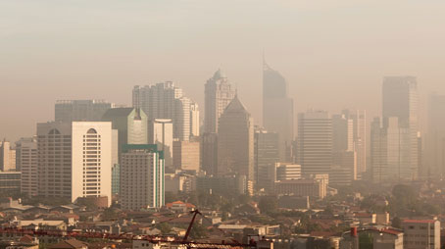
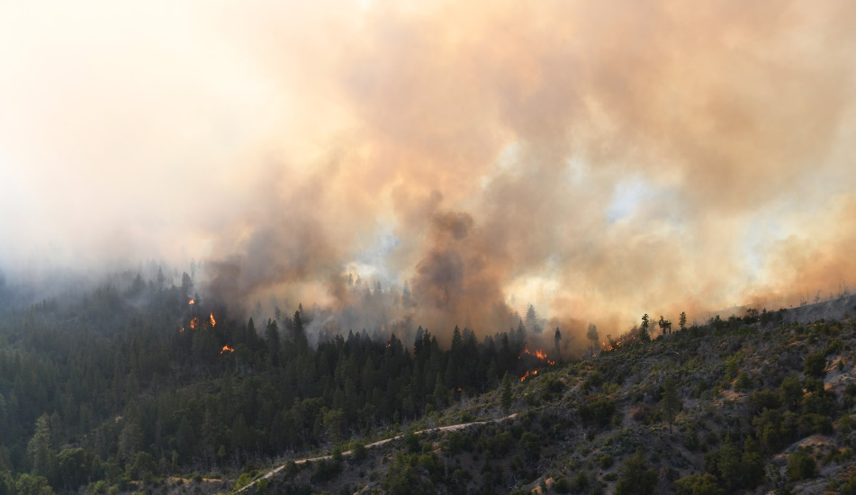
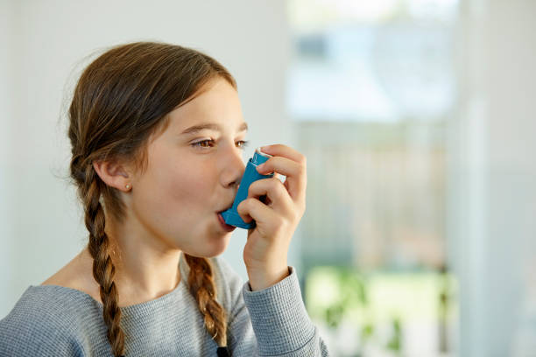
For more information
GeoXO
https://www.nesdis.noaa.gov/next-generation/geostationary-extended-observations-geoxo
NOAA Atmospheric Composition from Space
https://csl.noaa.gov/nacs
NOAA Pathfinder Initiative

